Slide 1
Business Process Management:
Concepts, Languages, Architectures
4th Edition
Mathias Weske
Figures Chapter 2

Slide 2
Legal Notice
This PowerPoint file contains figures used in
  Mathias Weske, Business Process Management: Concepts, Languages, Architectures, 4th edition, 2024, Hardcover ISBN: 978-3-662-69517-3, eBook ISBN: 978-3-662-69518-0 © Springer-Verlag GmbH Germany, part of Springer Nature 2024, 2019, 2012, 2007
Each slide contains one picture in PNG-format with caption and copyright notice. It is illegal to remove the copyright notice from any of the figures.
Commercial use in any form is not allowed without prior written approval by Springer-Verlag
2

Slide 3
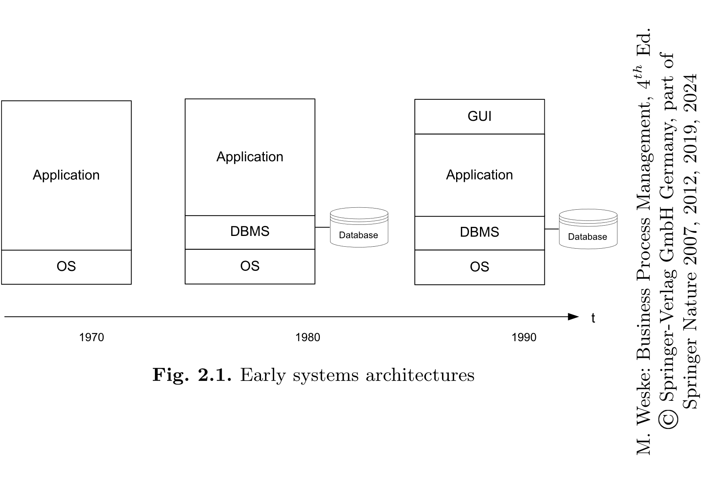

Slide 4
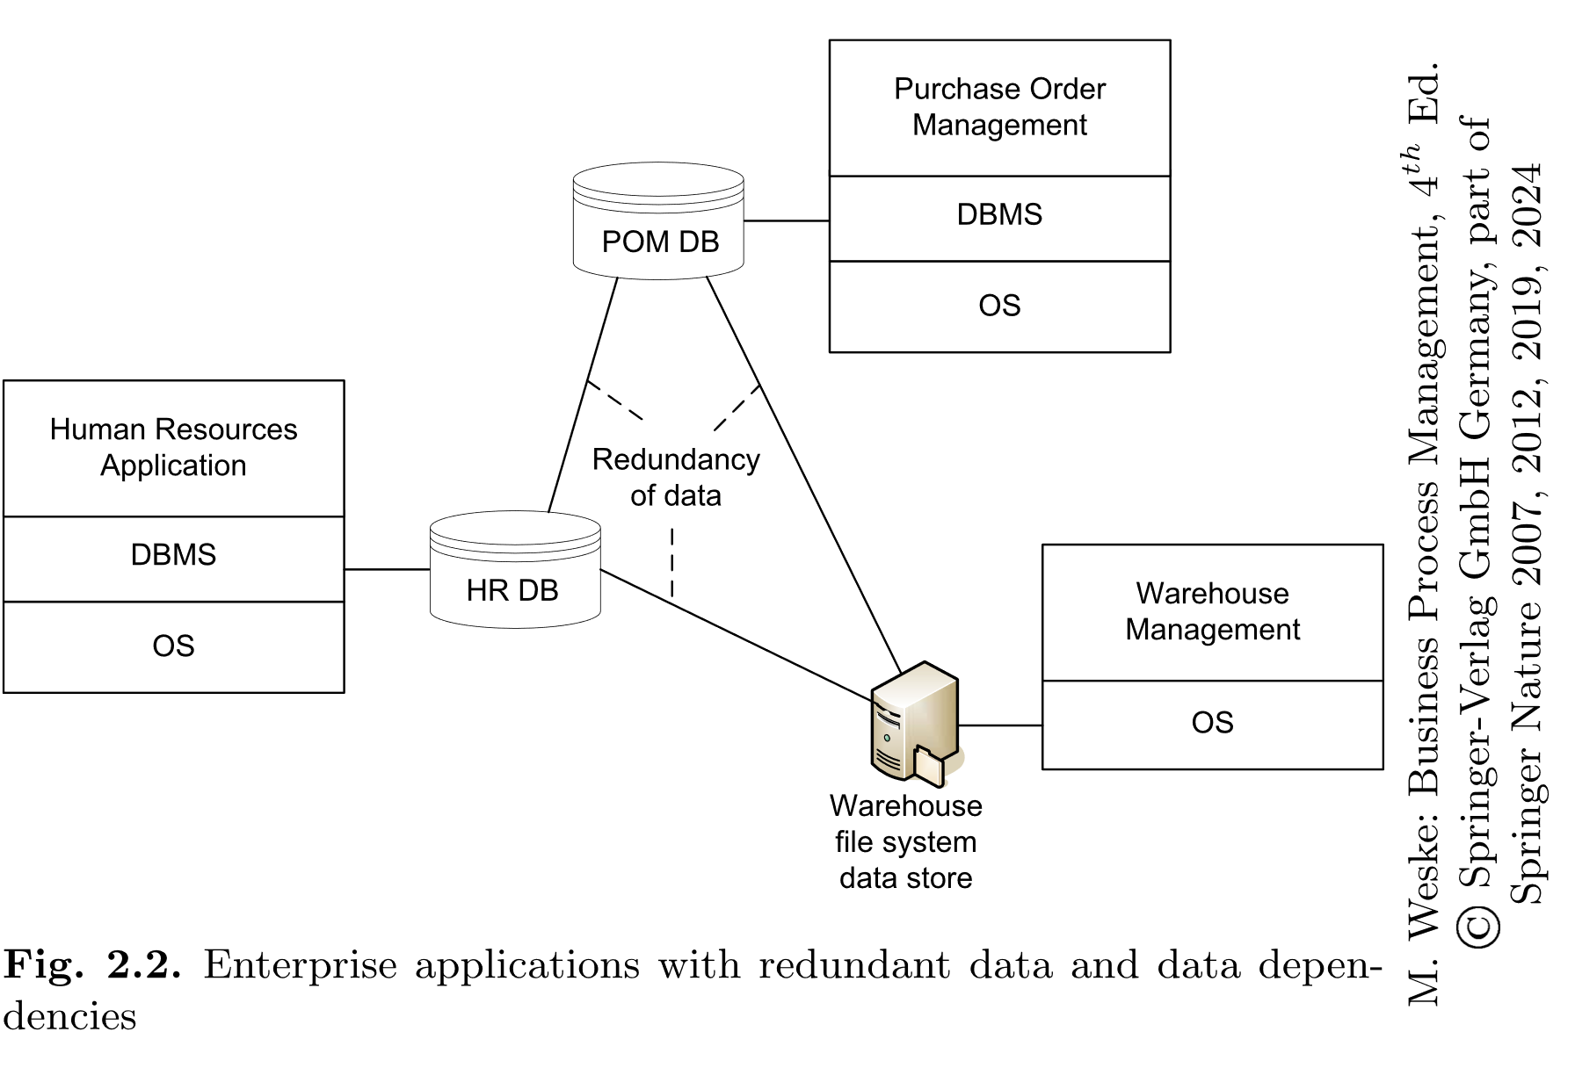

Slide 5
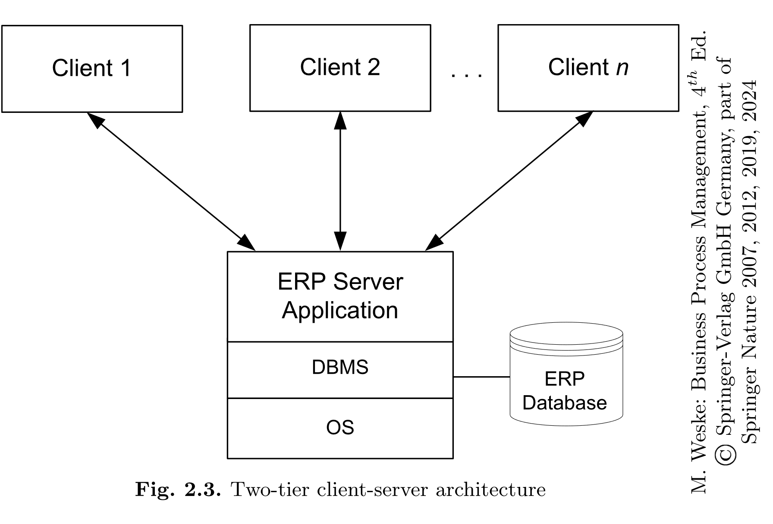

Slide 6
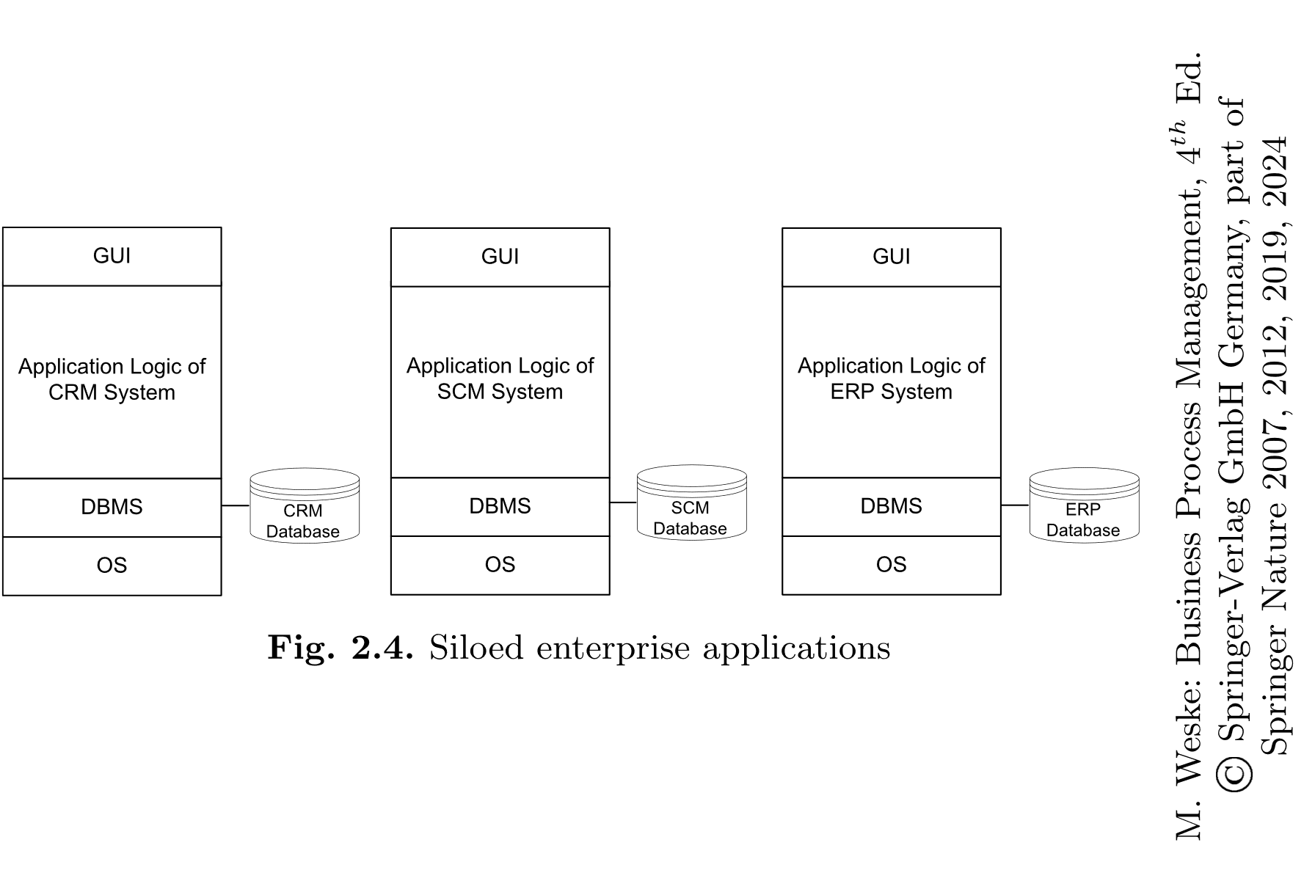

Slide 7
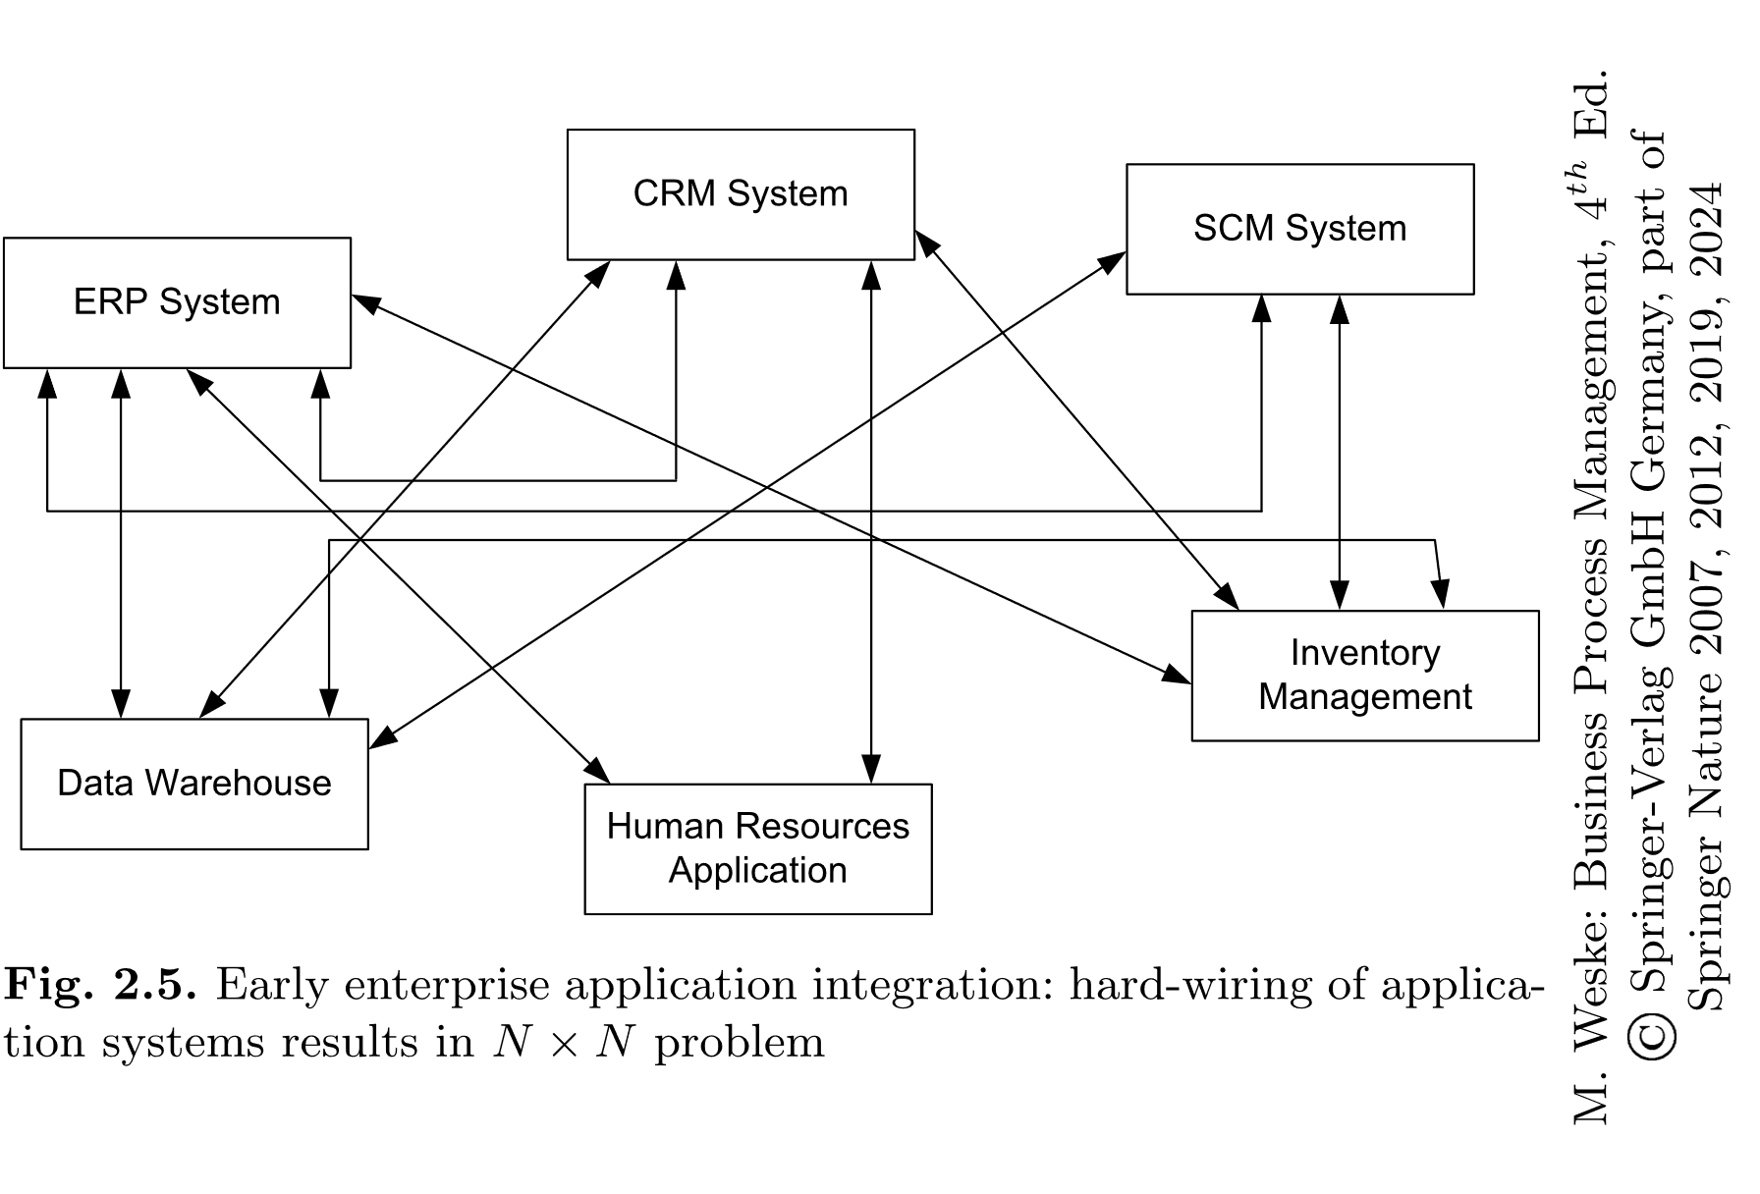

Slide 8
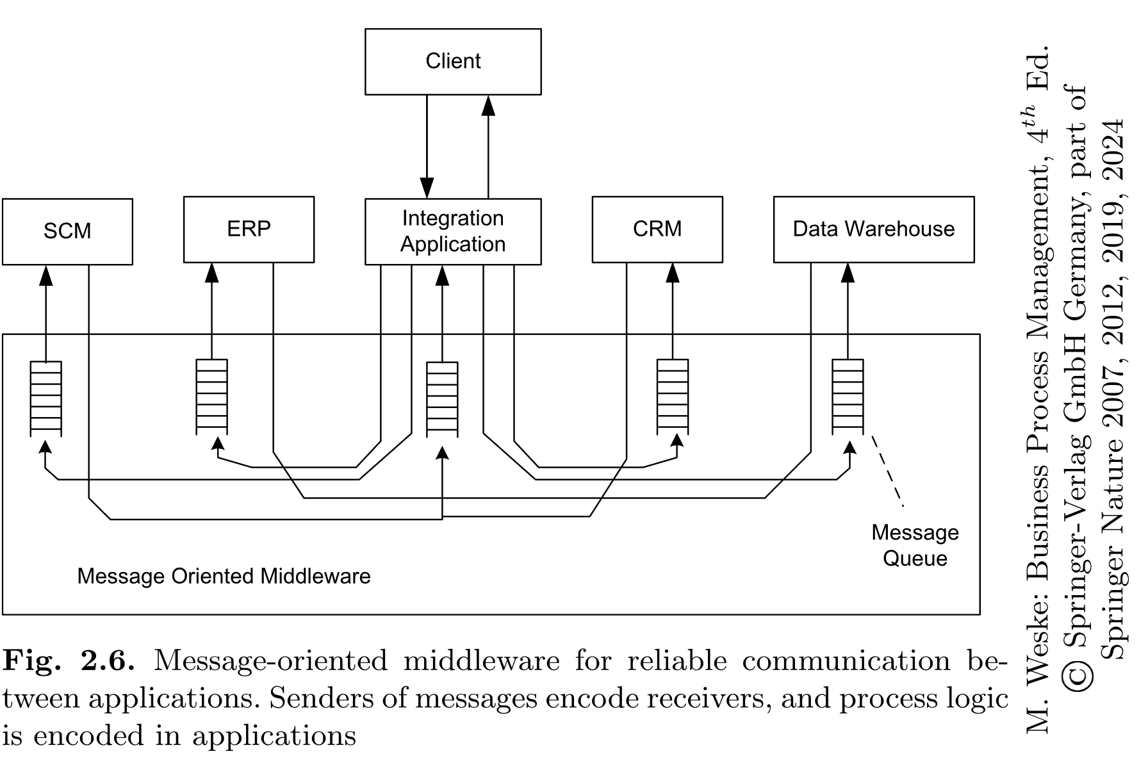

Slide 9
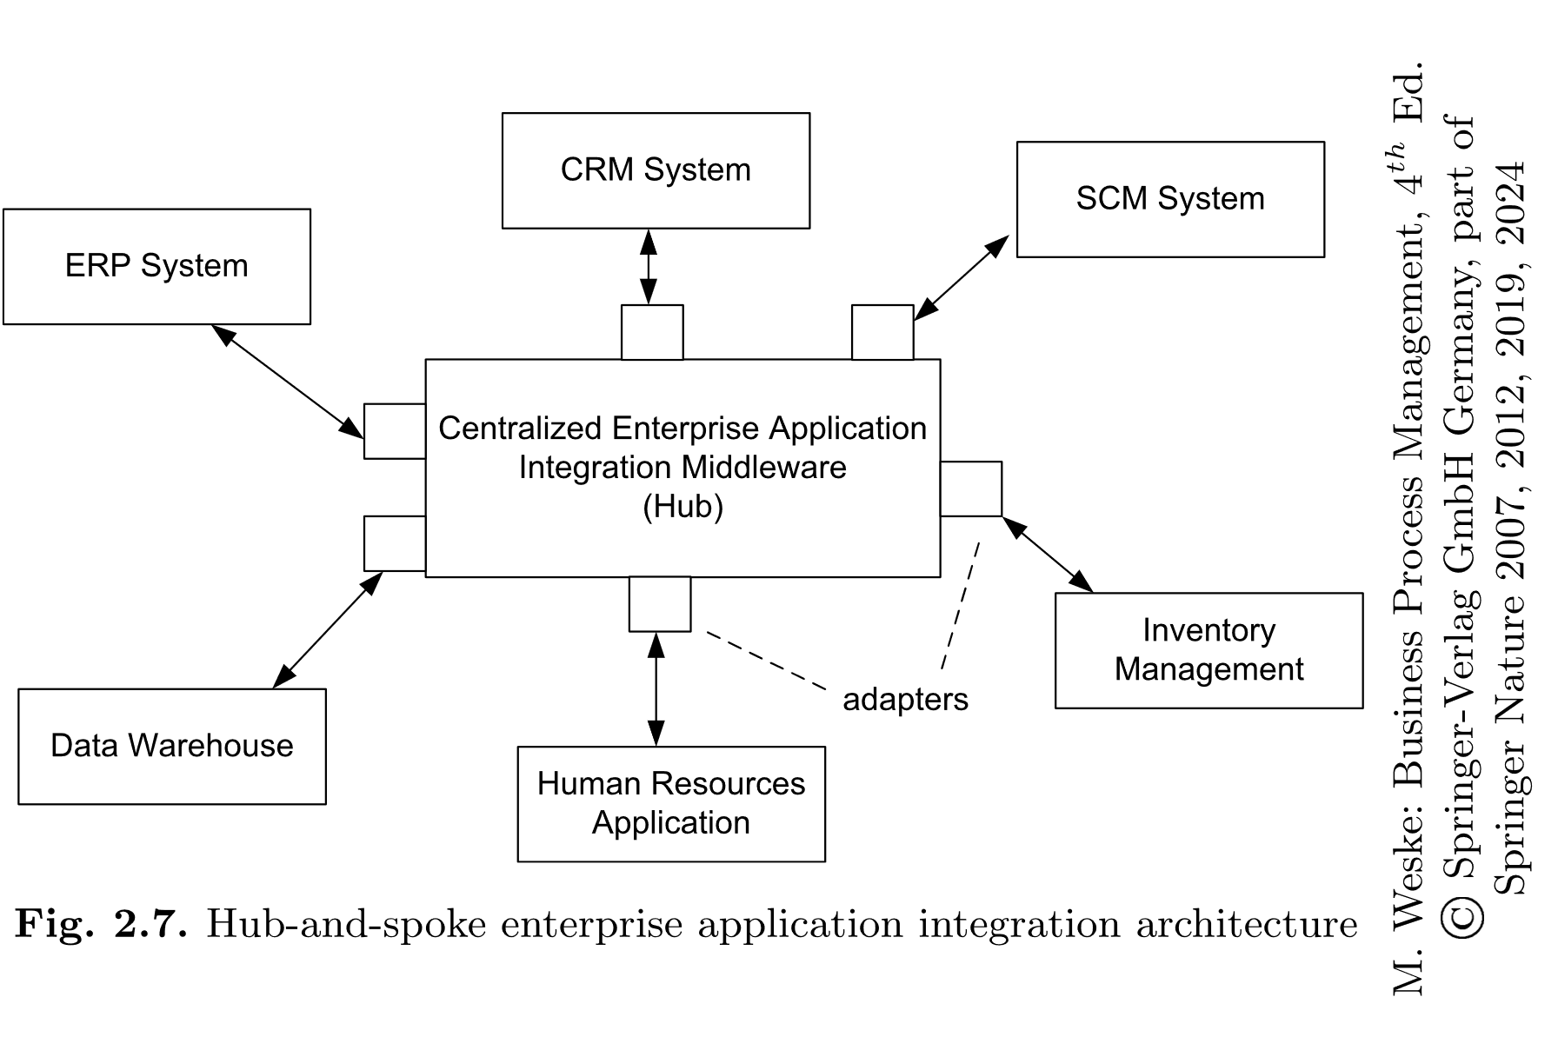

Slide 10
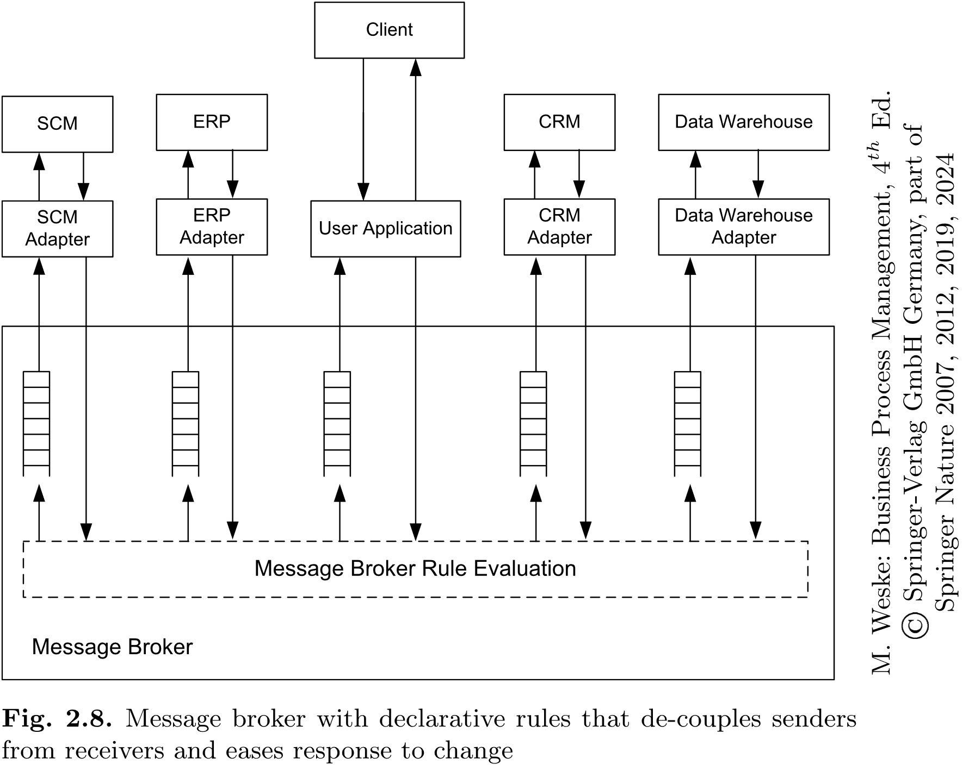

Slide 11
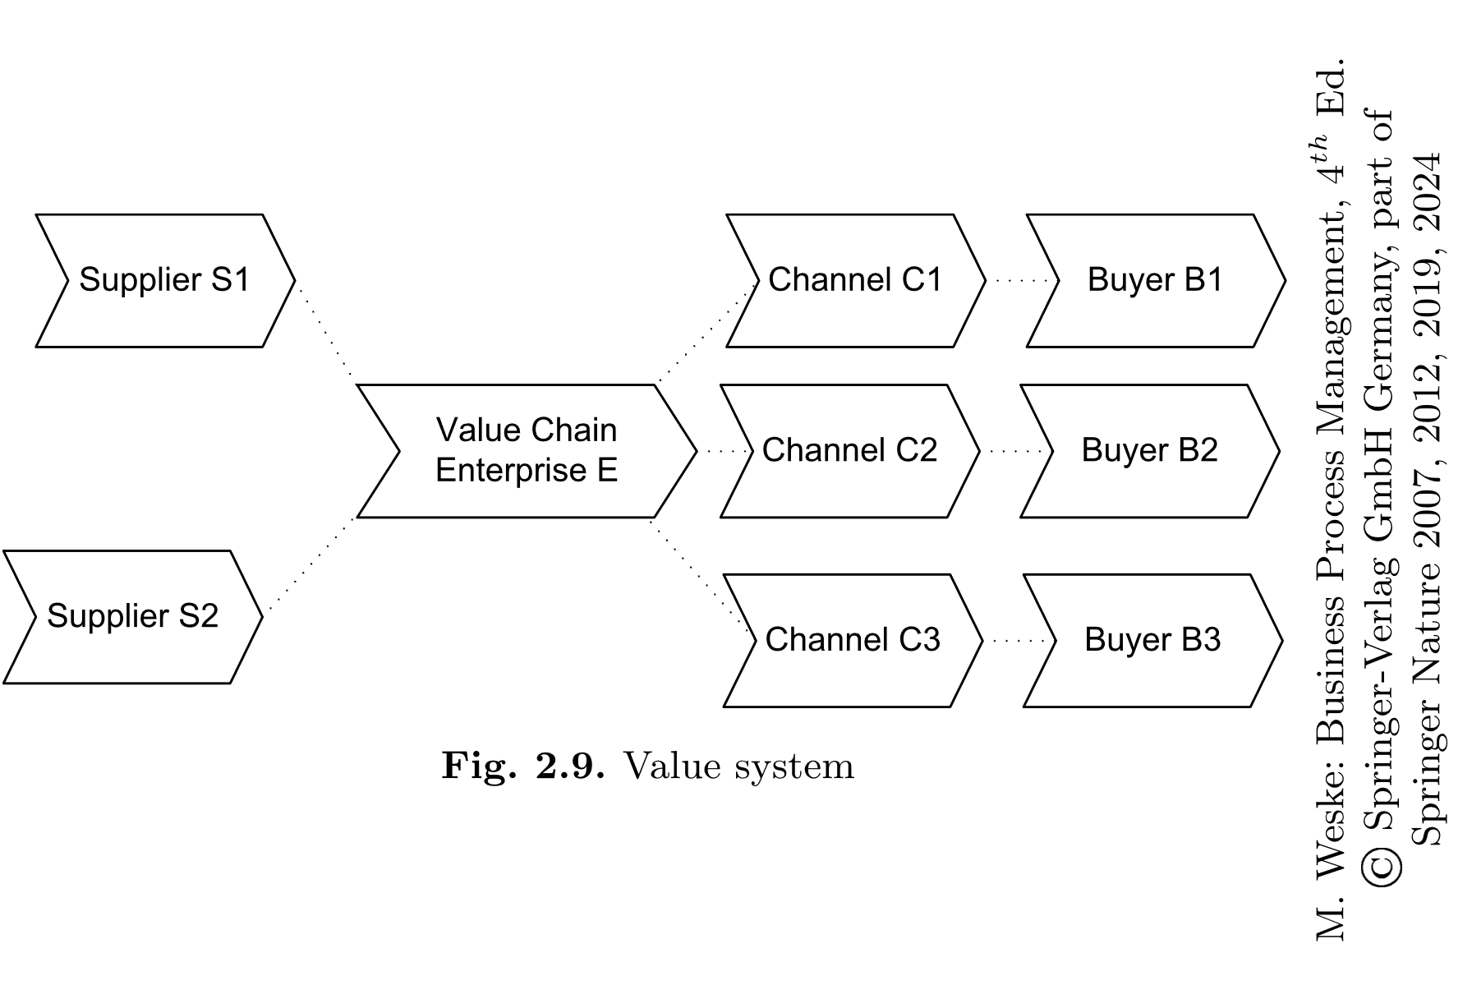

Slide 12
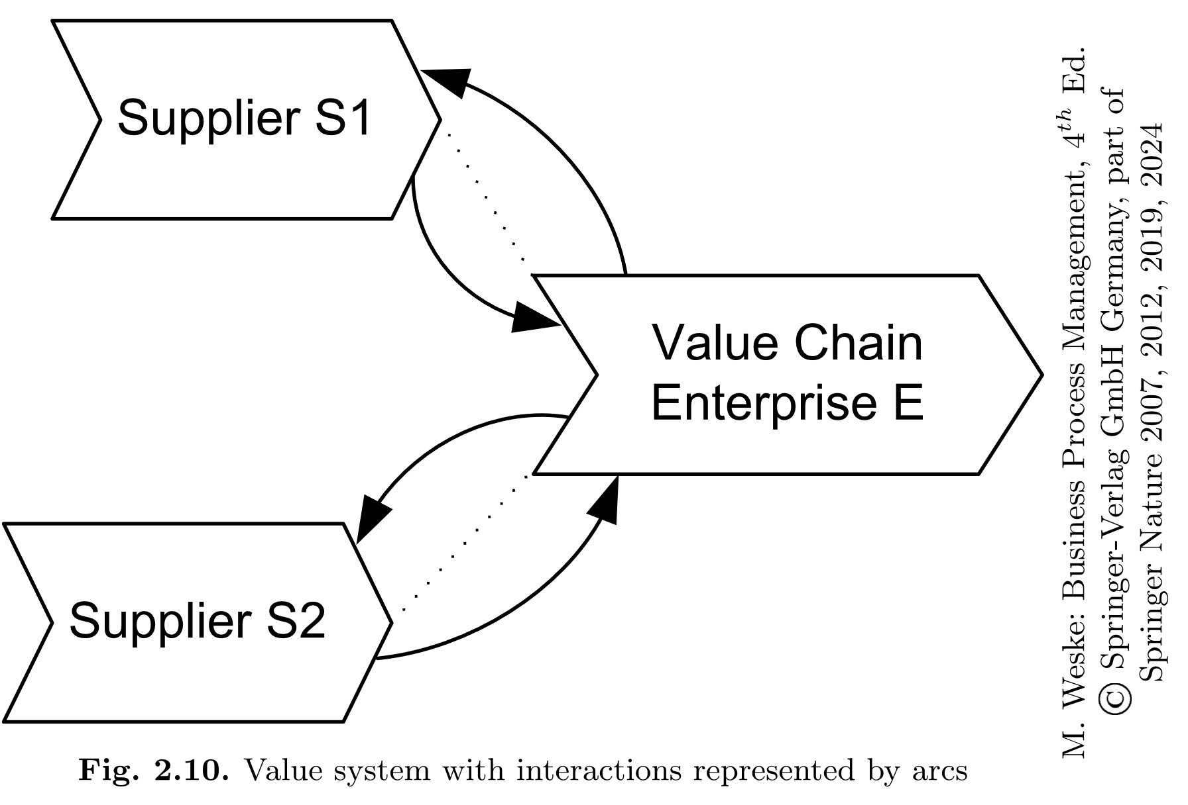

Slide 13
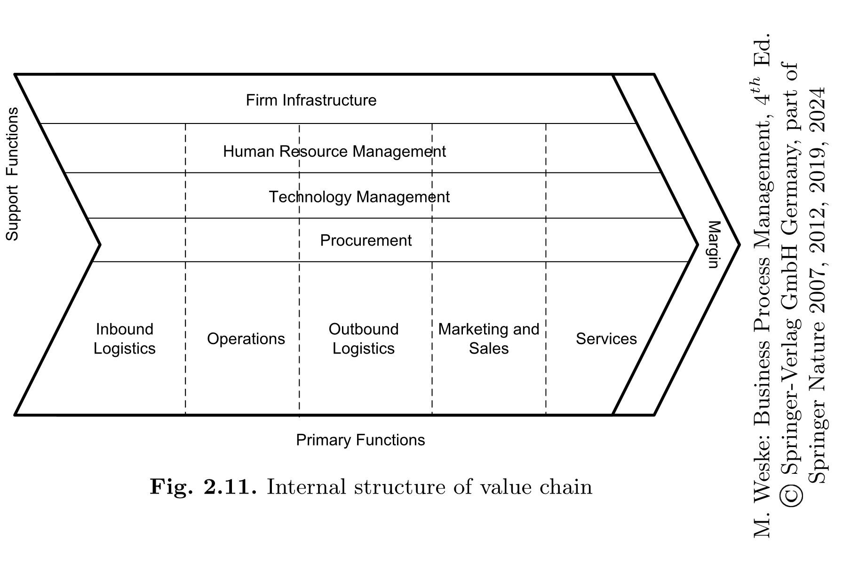

Slide 14
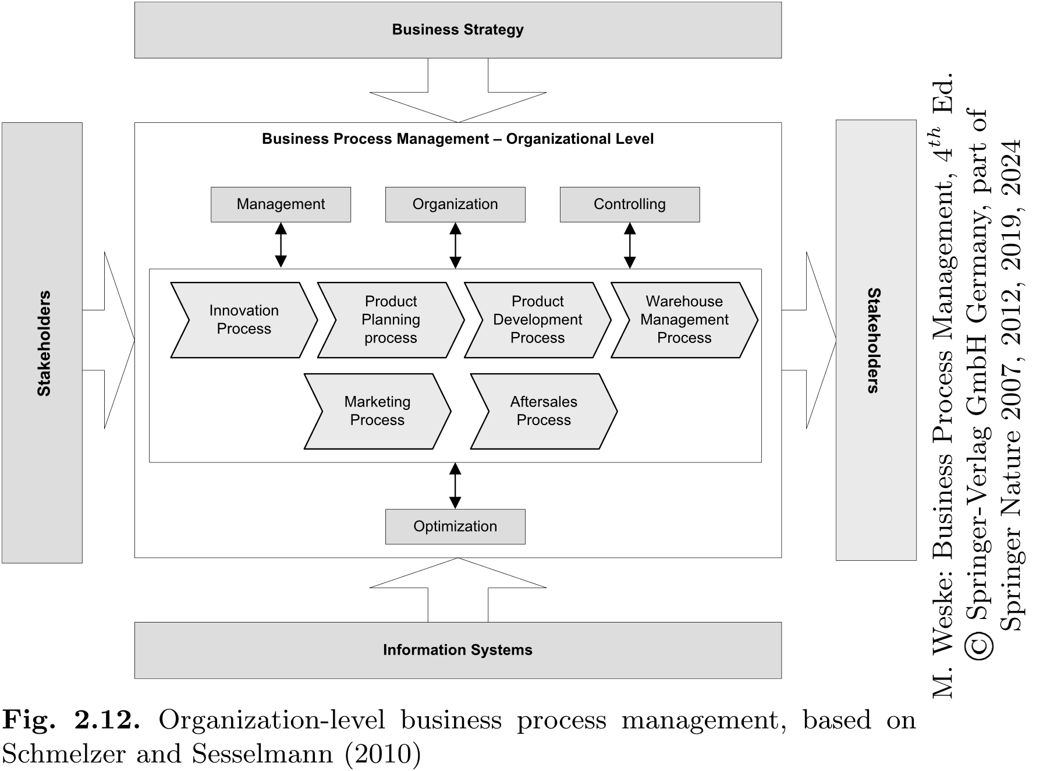

Slide 15
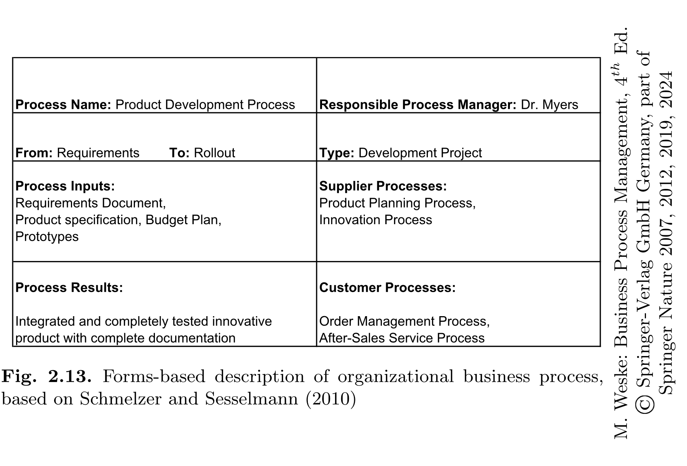

Slide 16
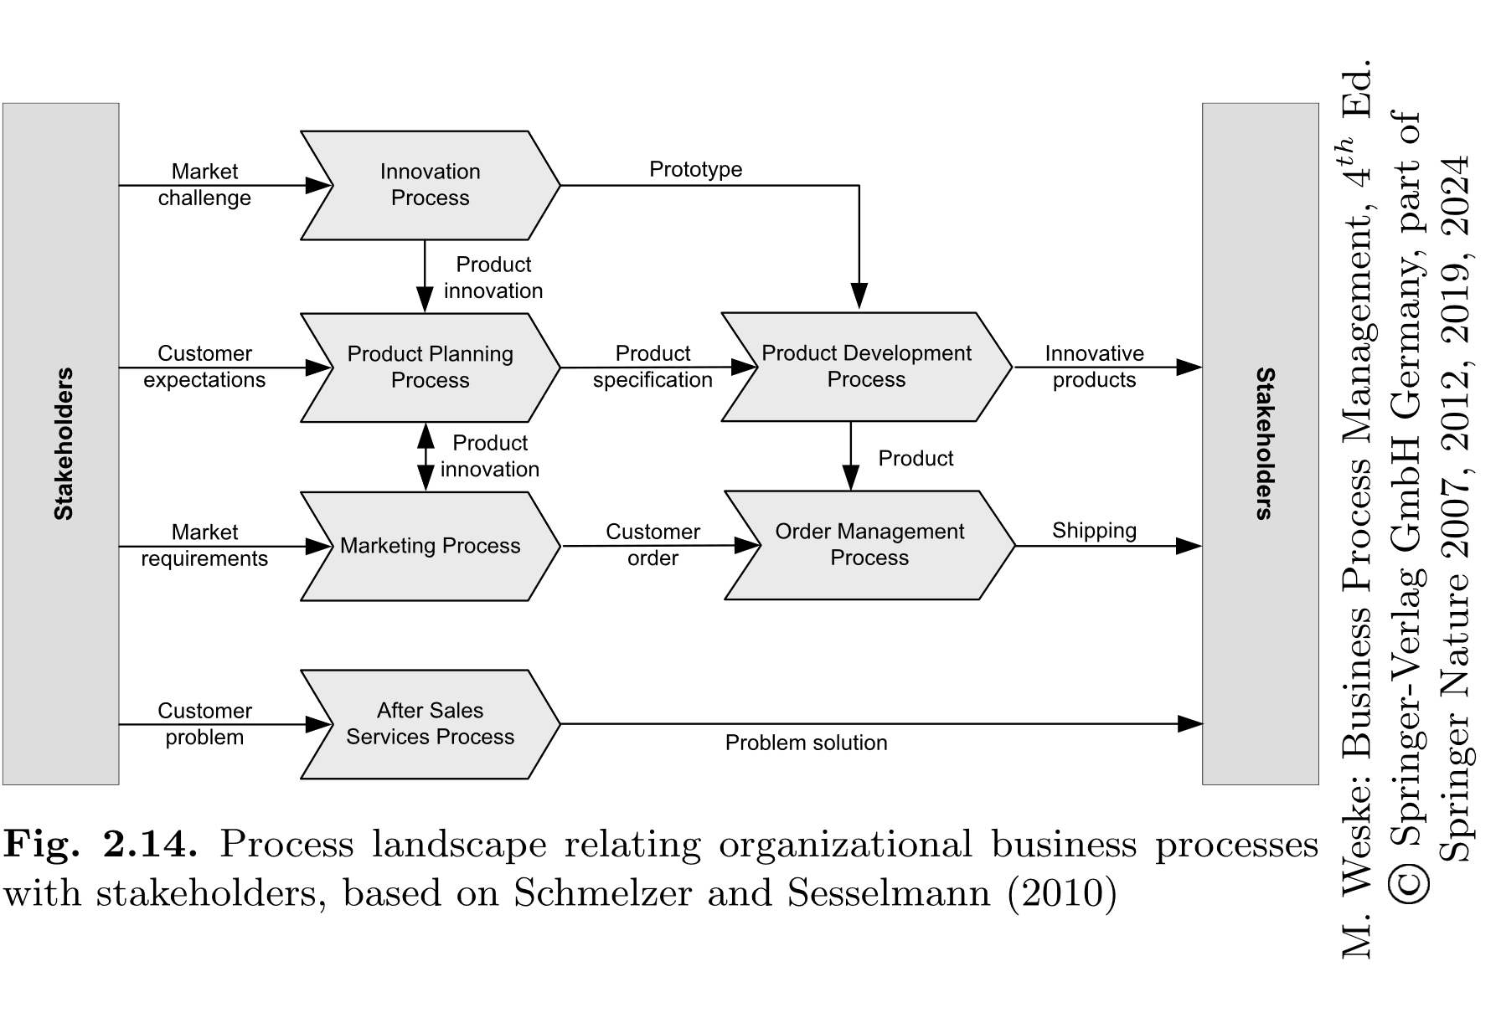

Slide 17
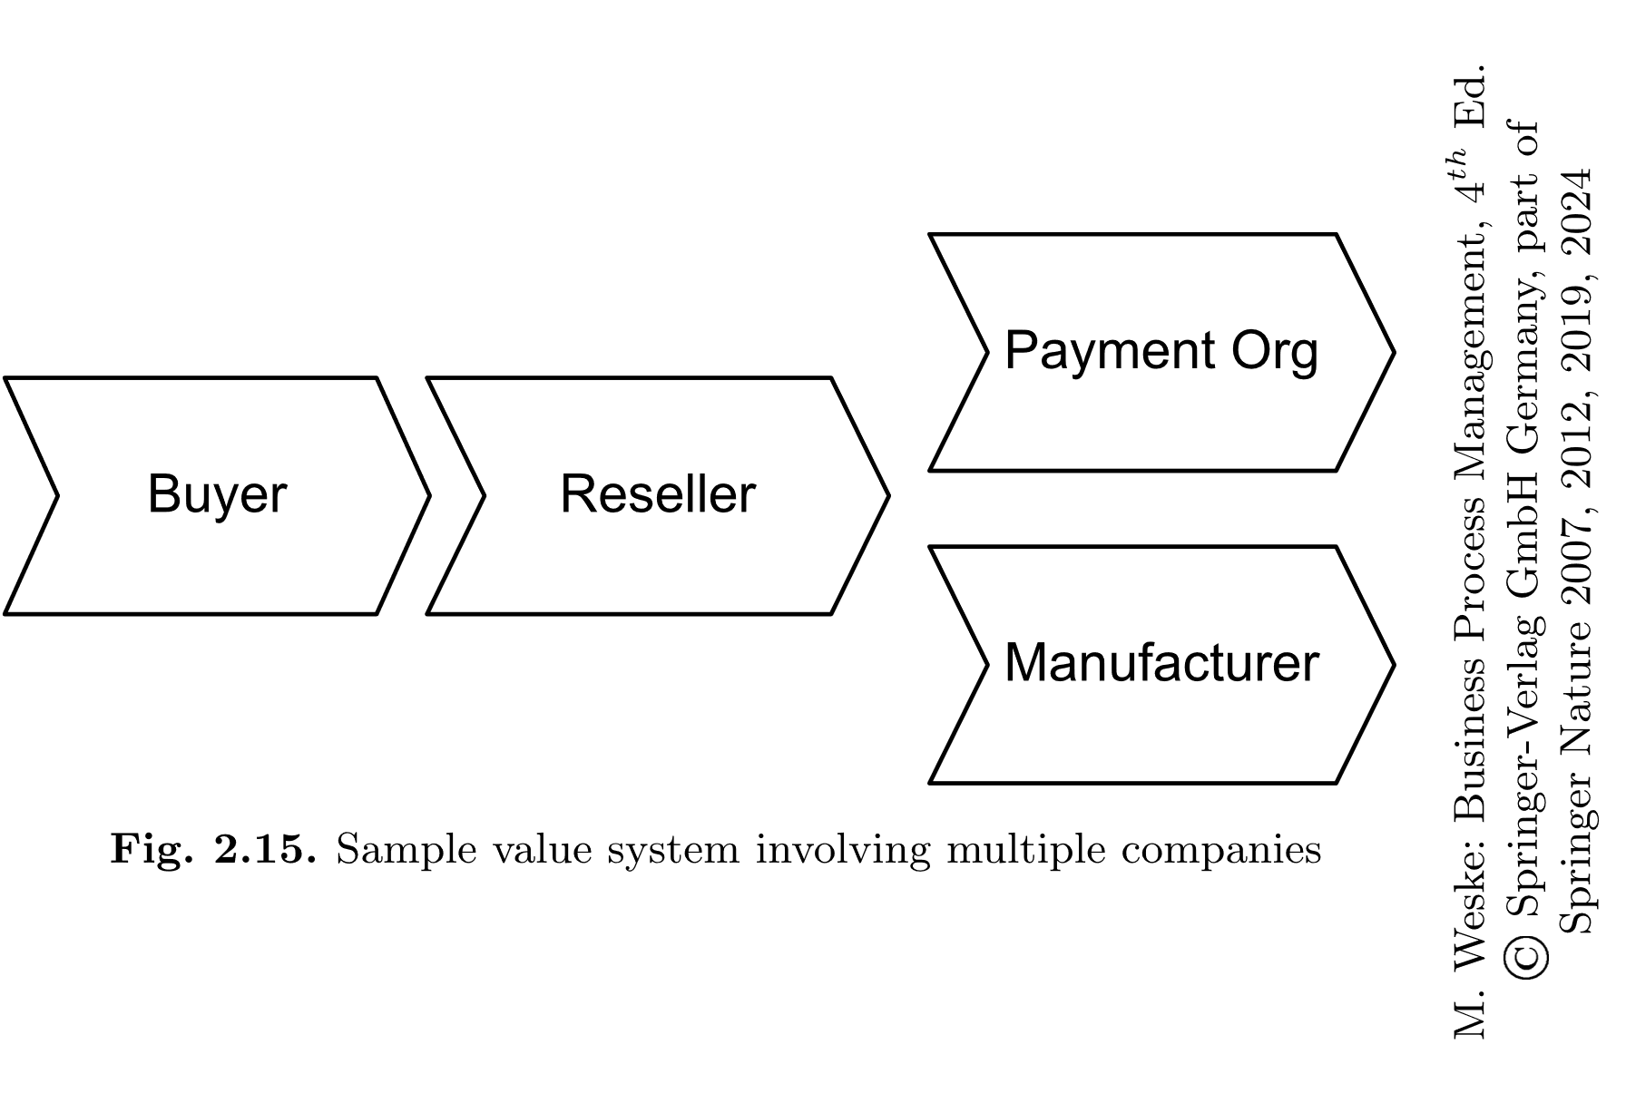

Slide 18
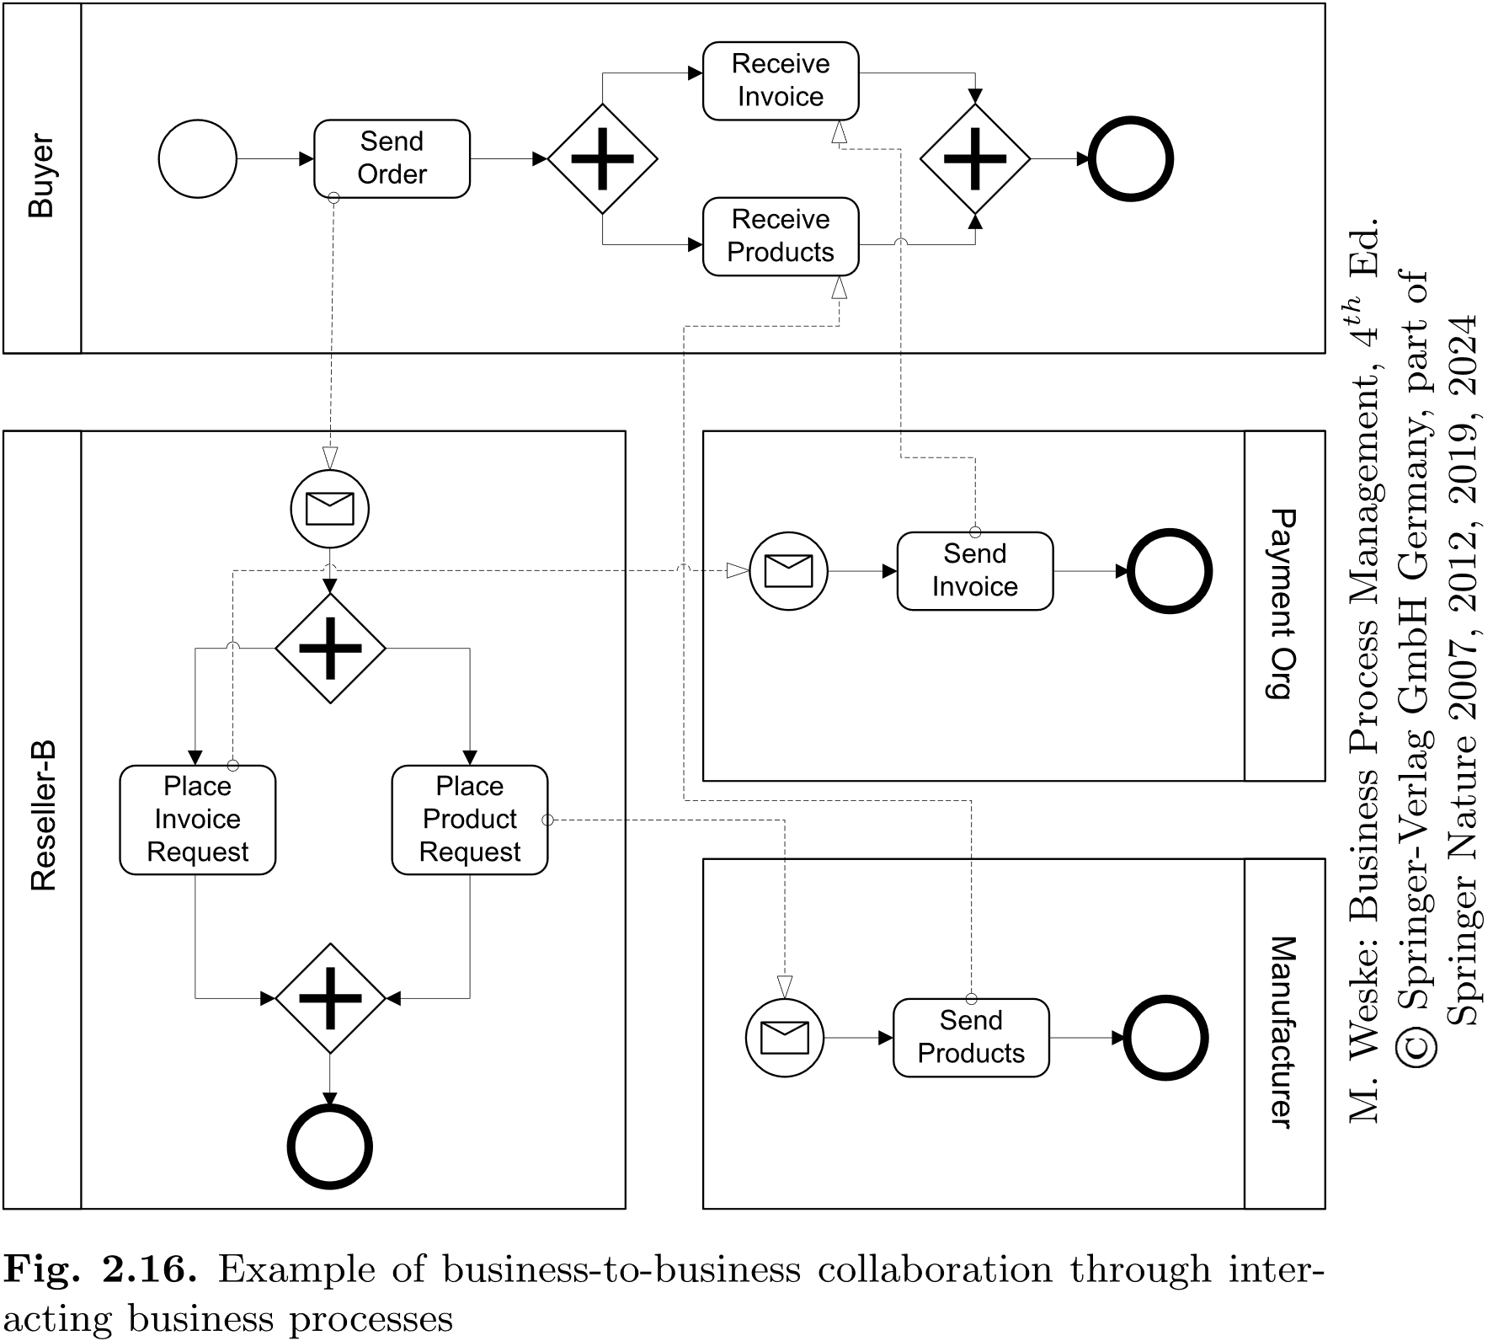

Slide 19
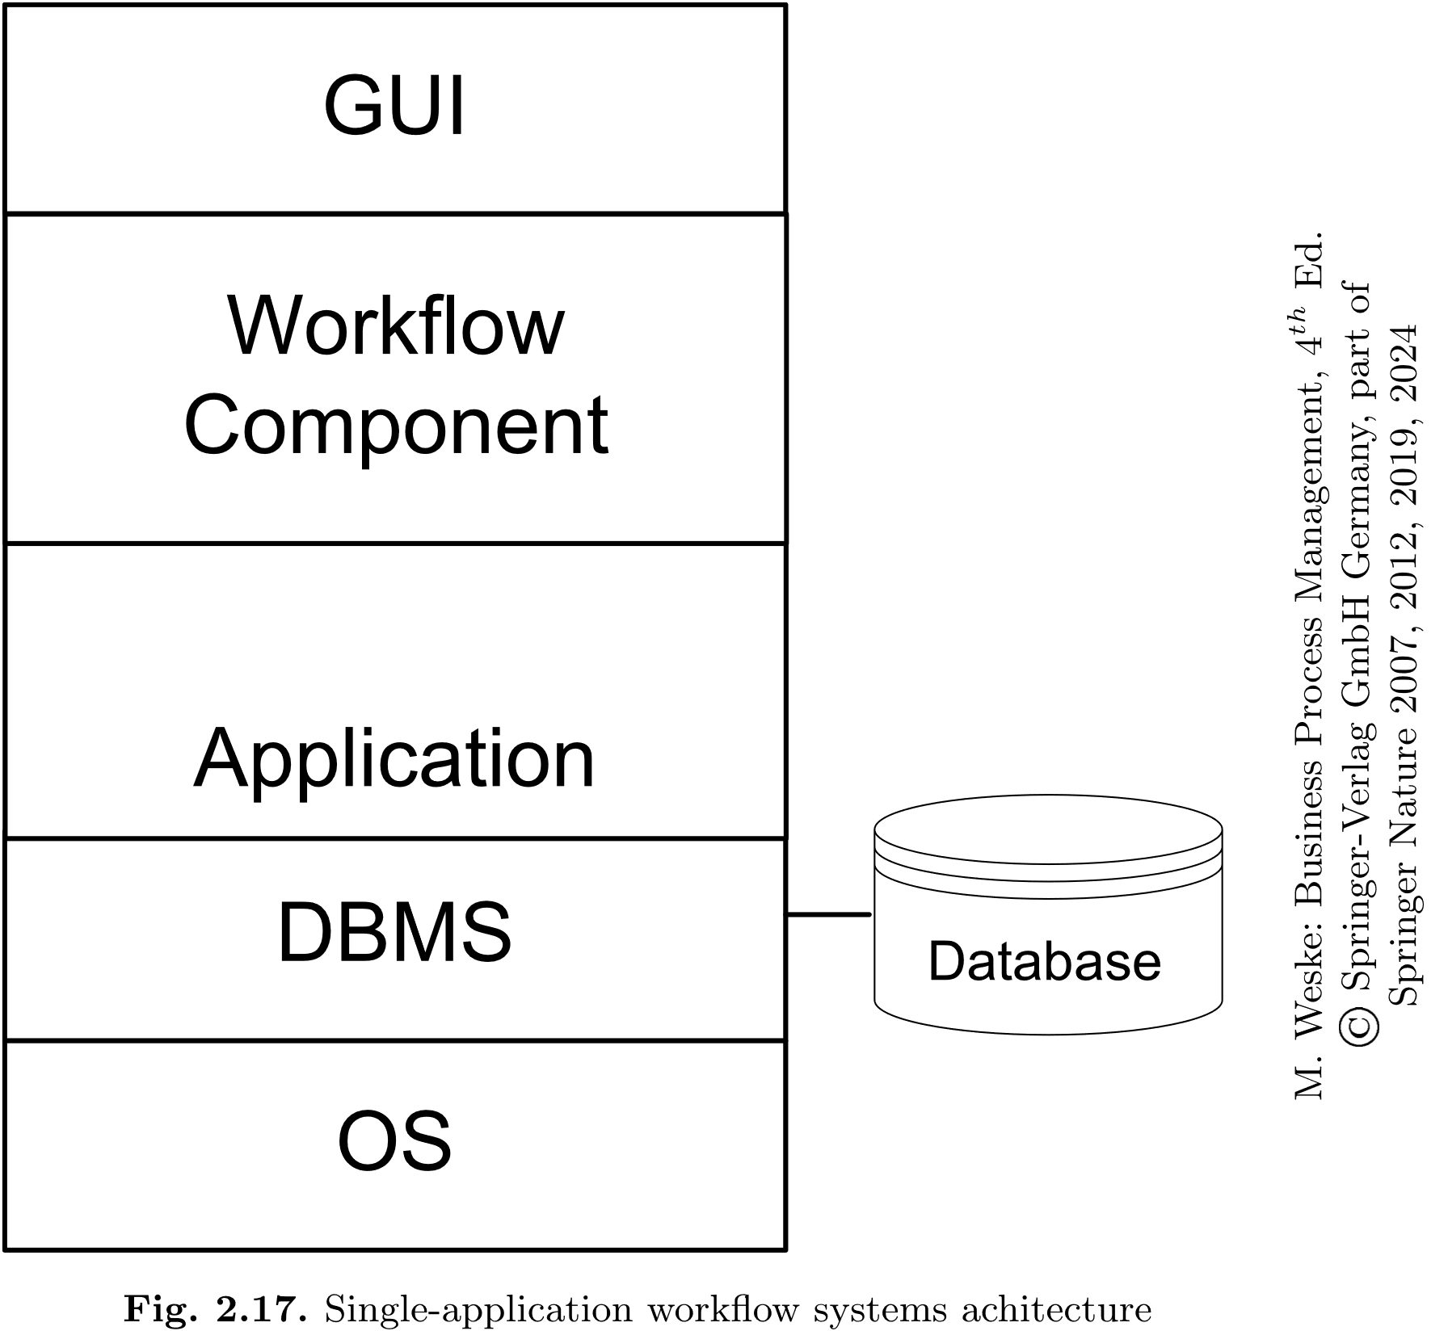

Slide 20
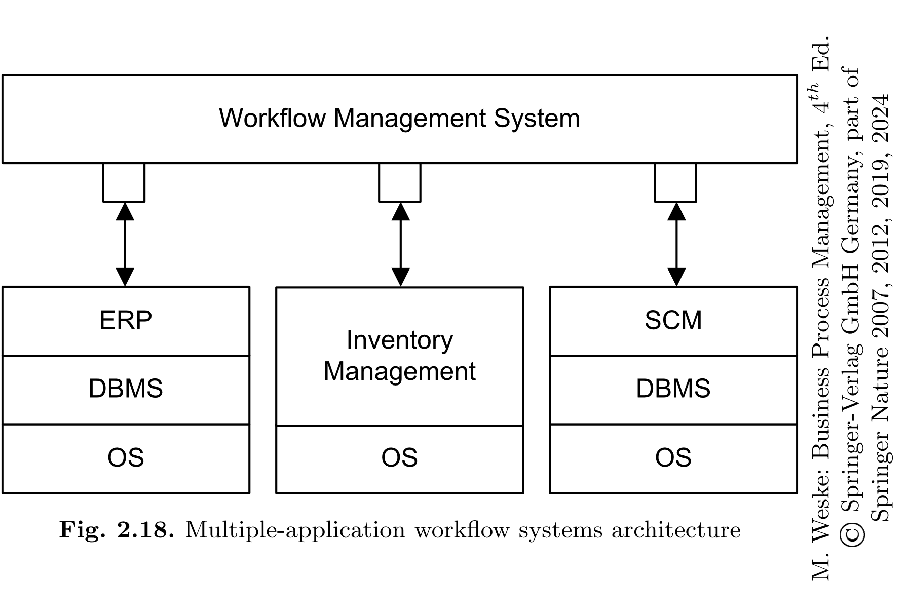

Slide 21
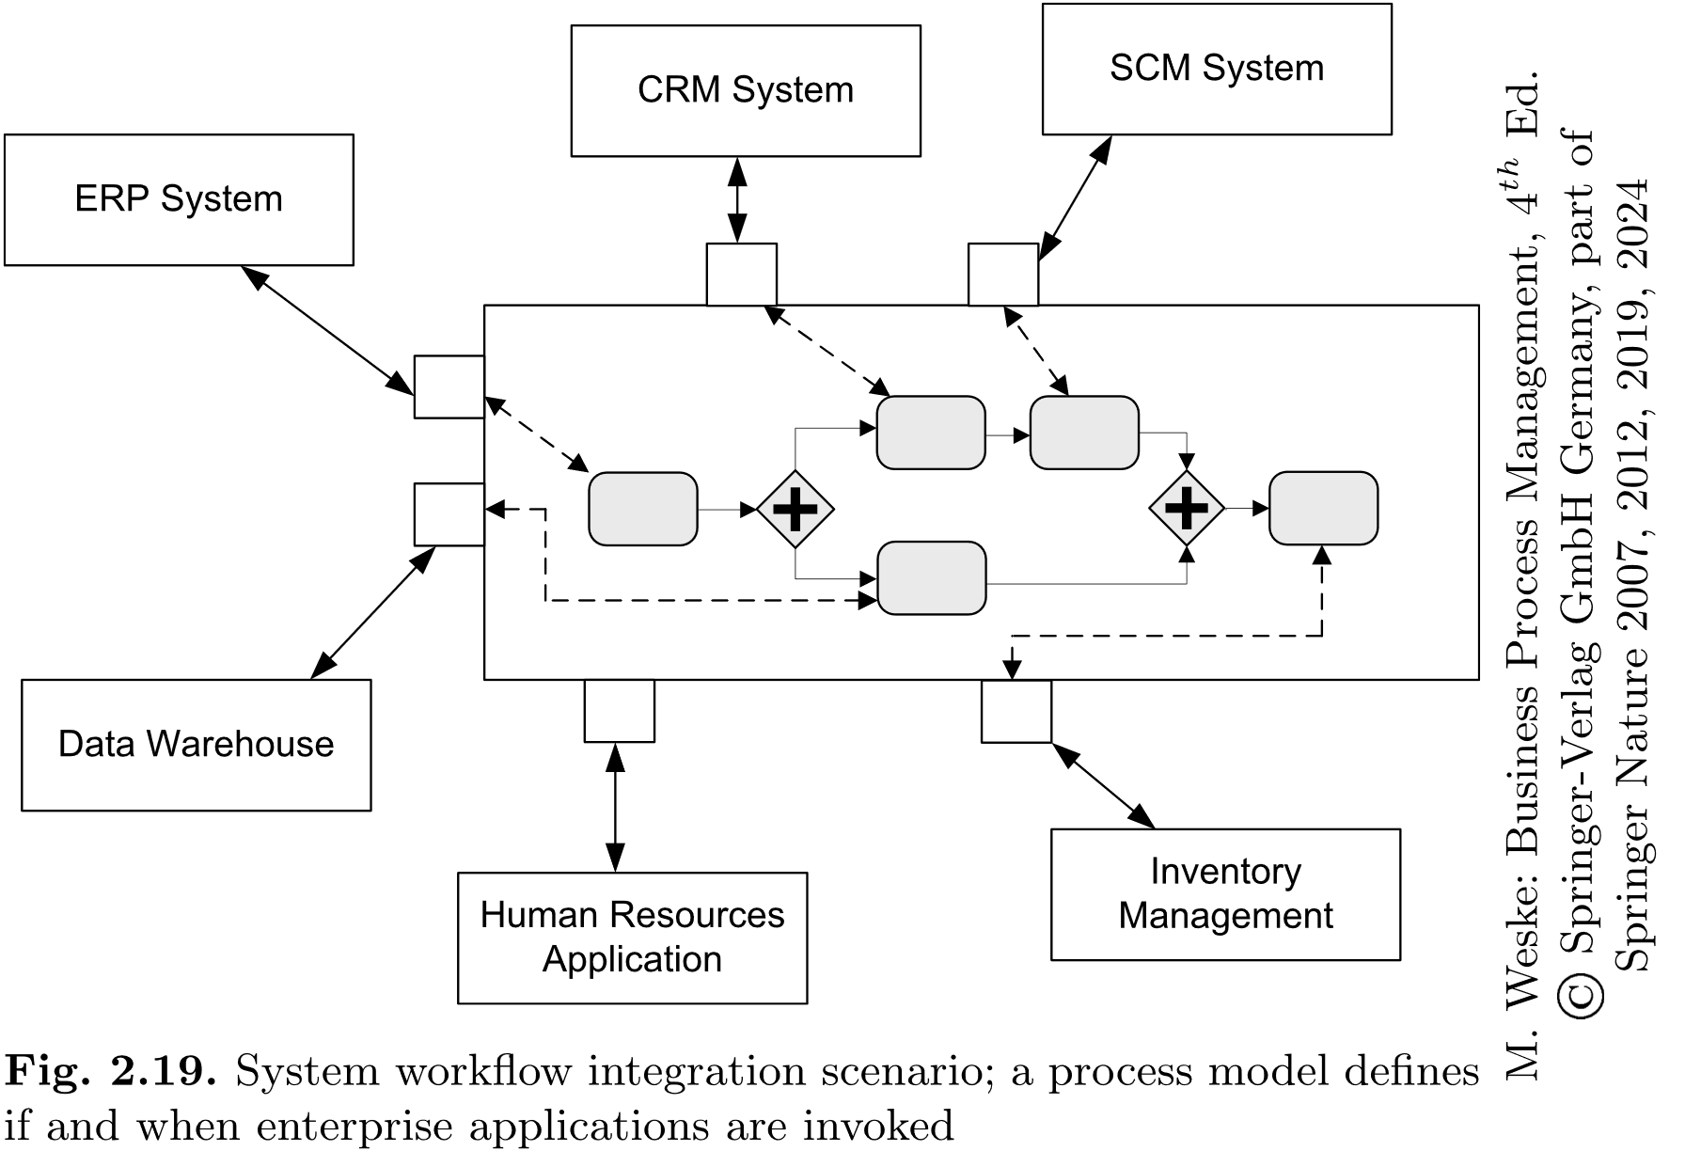

Slide 22
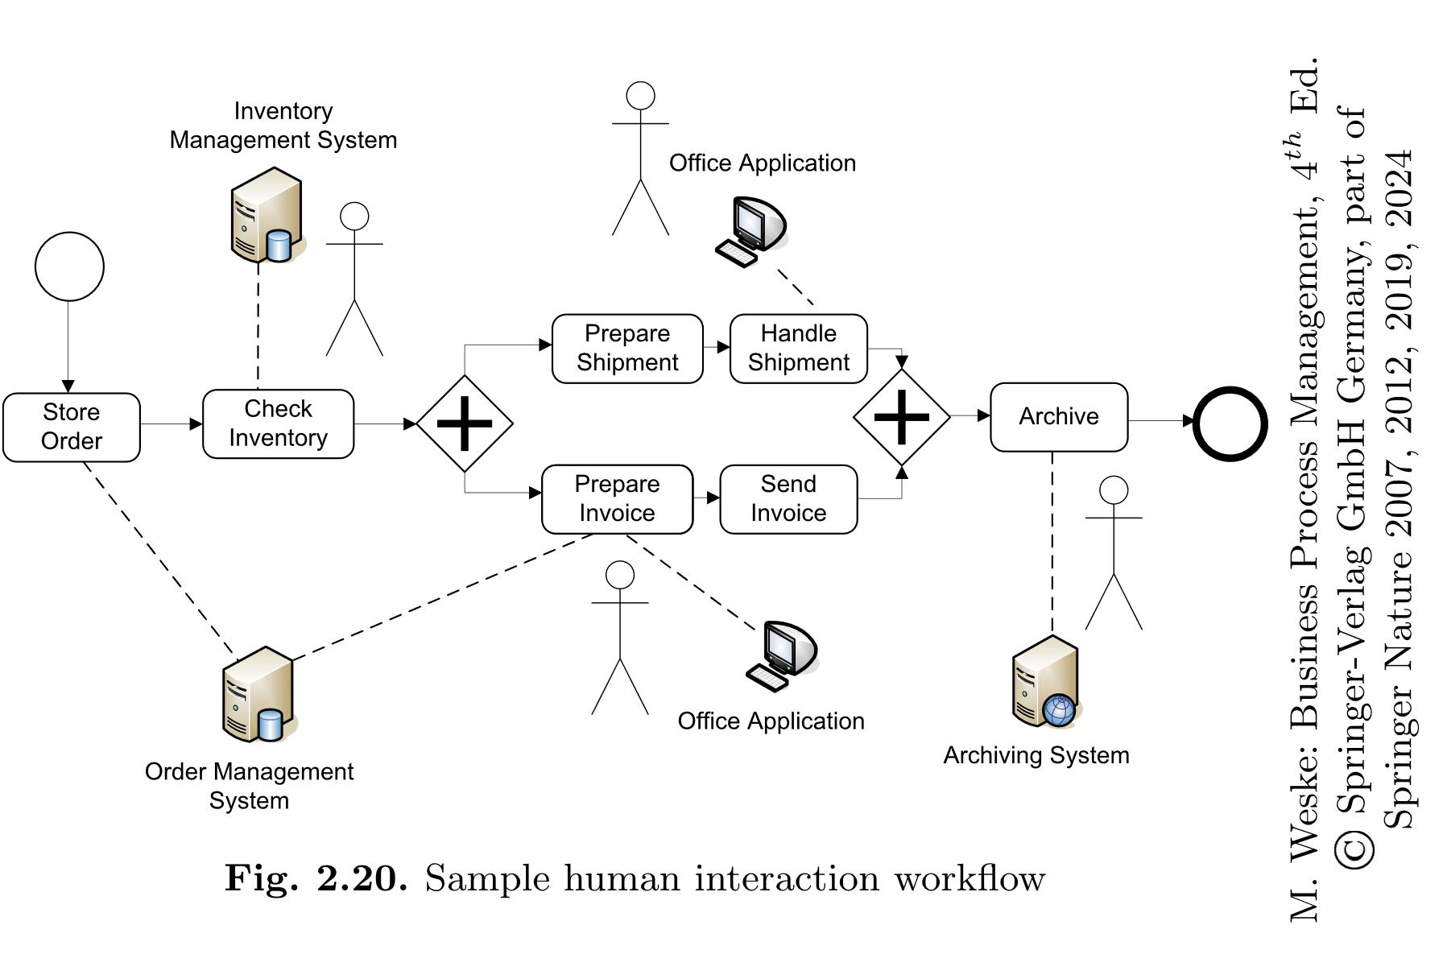

Slide 23
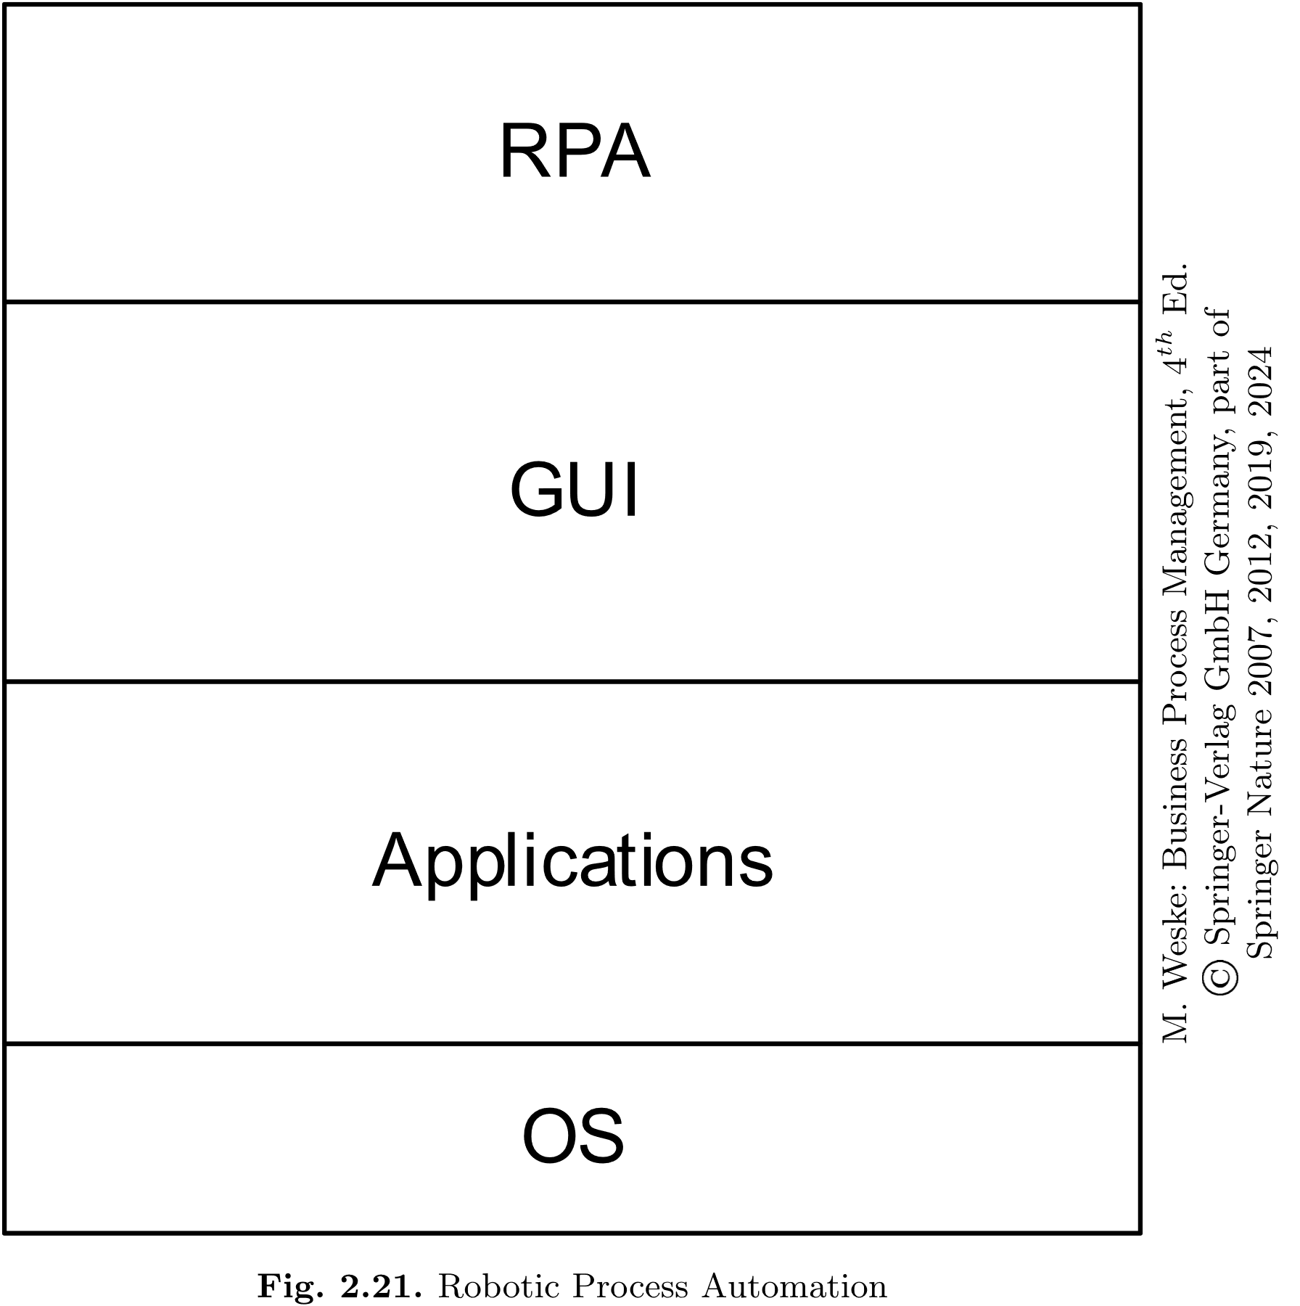

Slide 24
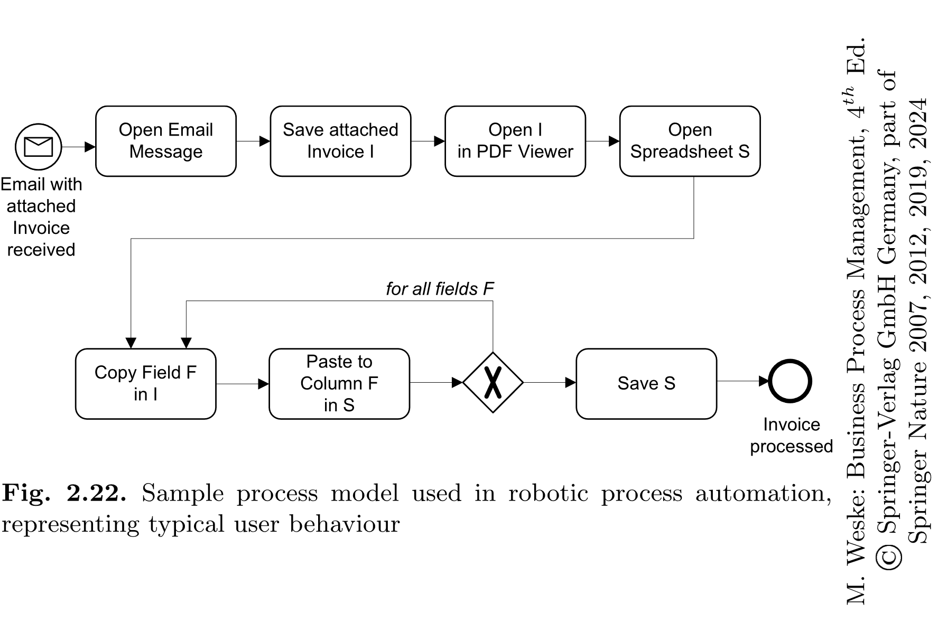

Slide 25
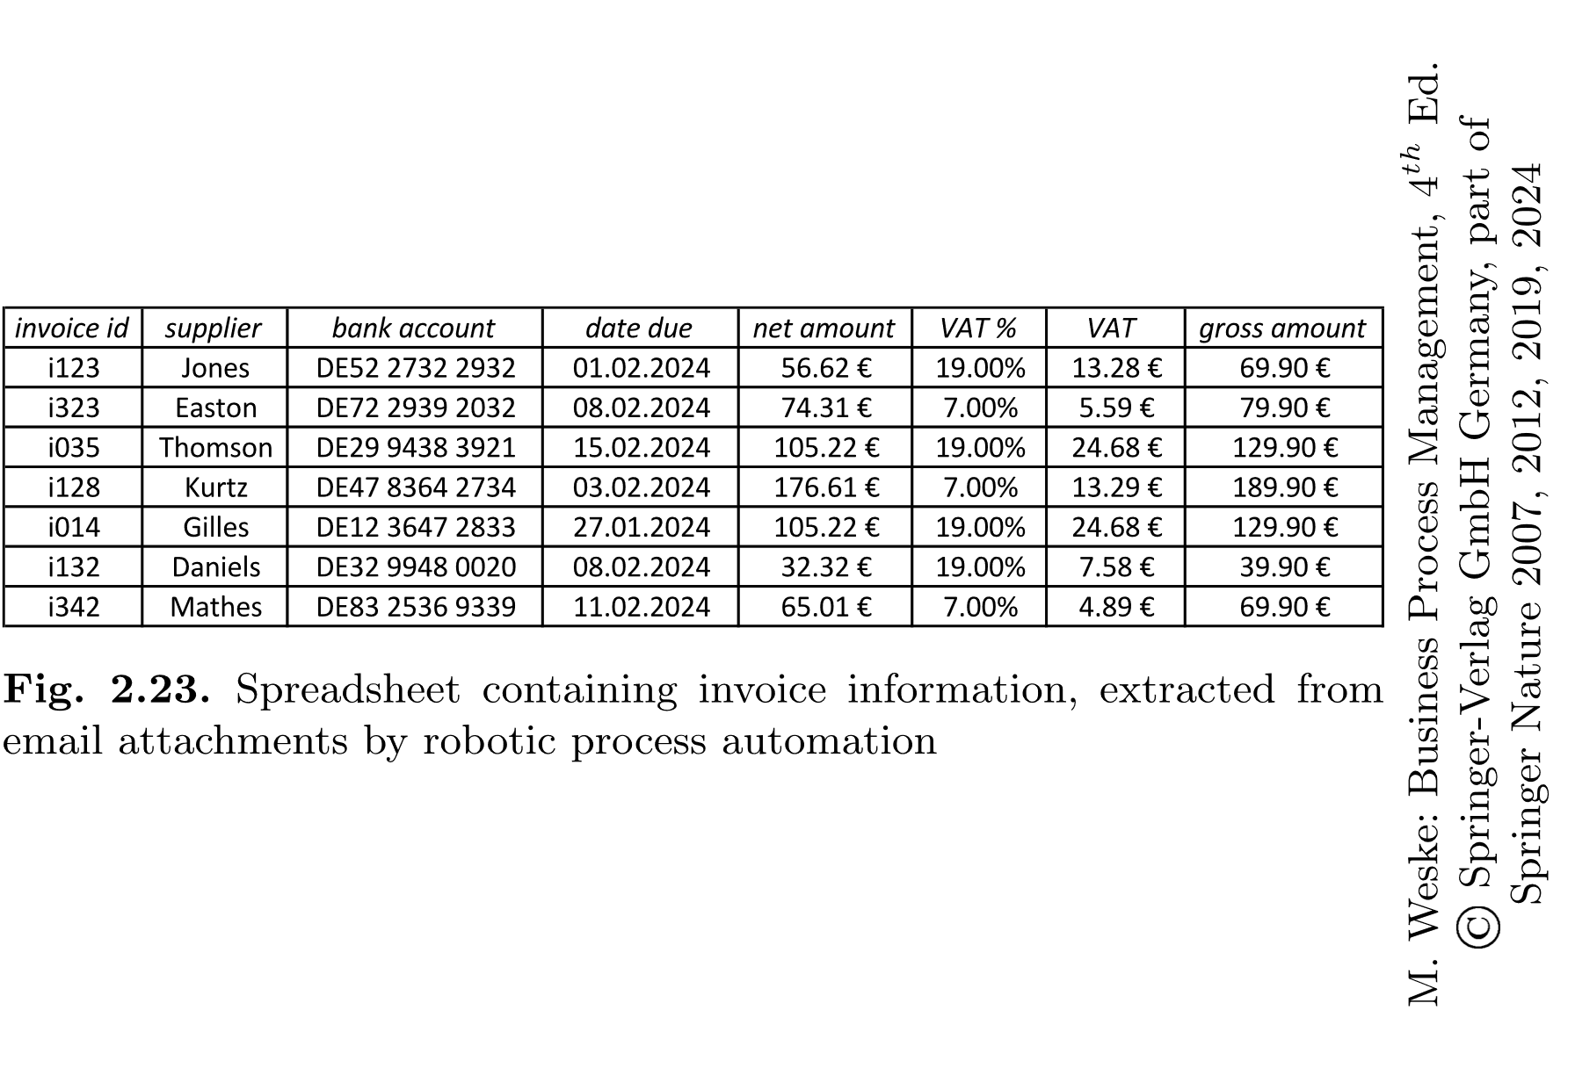

Slide 26
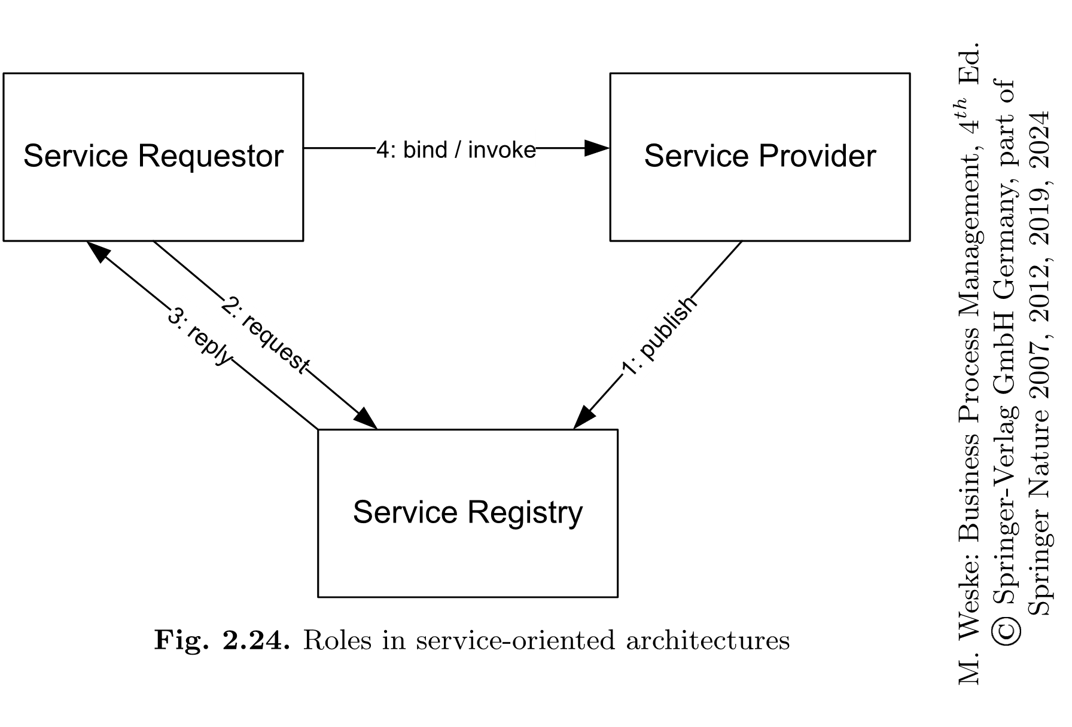

Slide 27
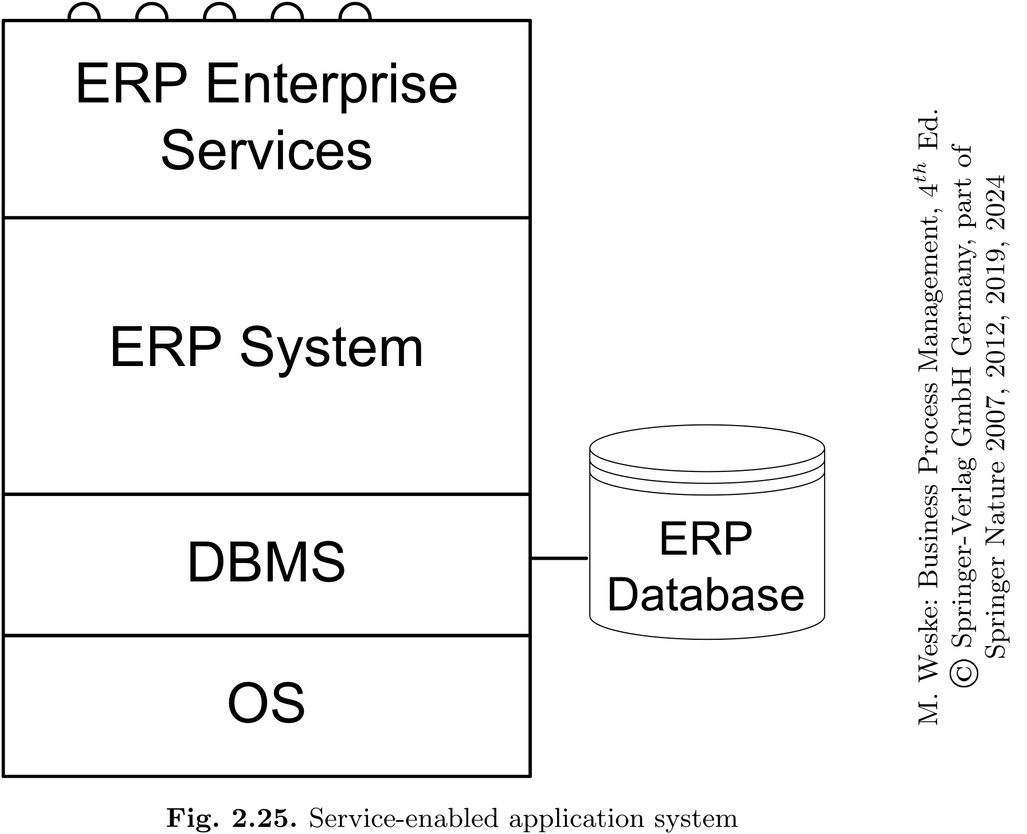

Slide 28
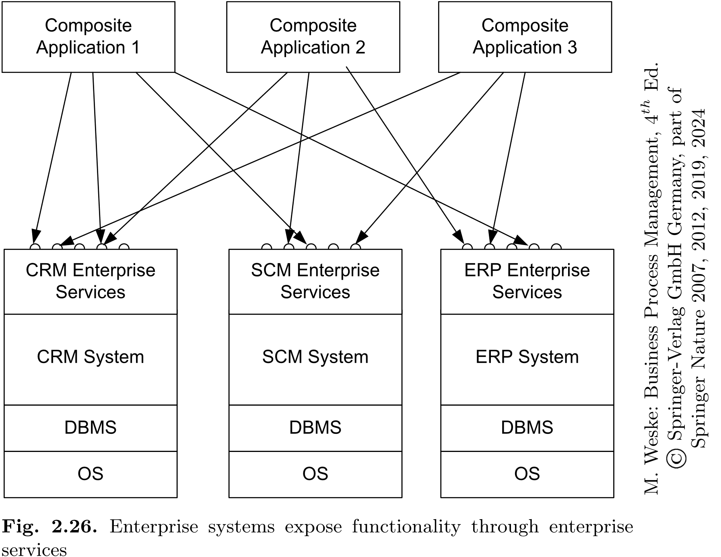

Slide 29
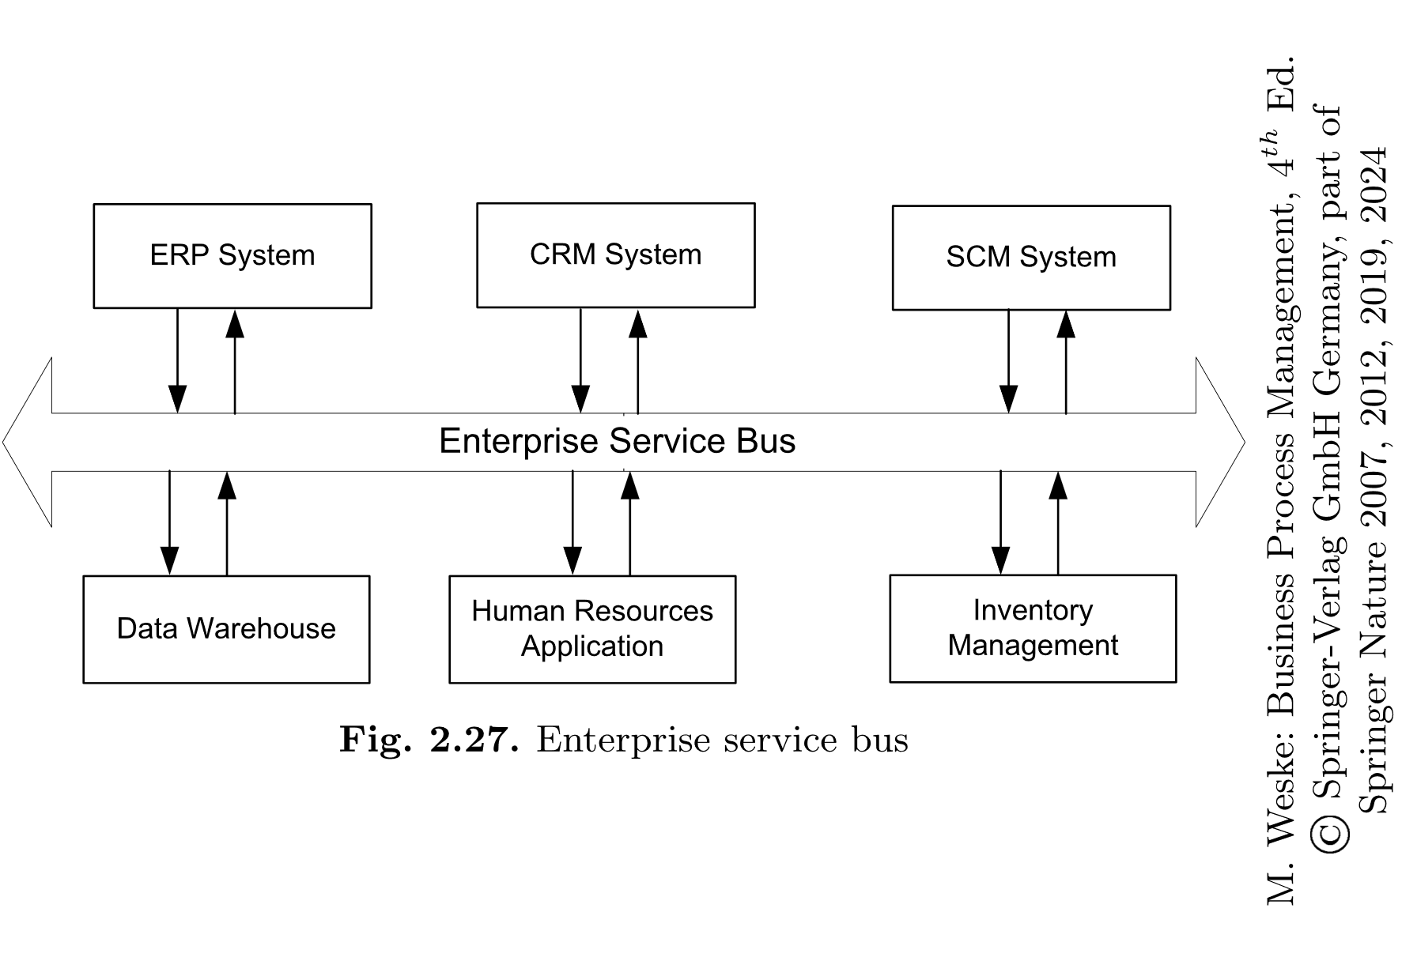

Slide 30
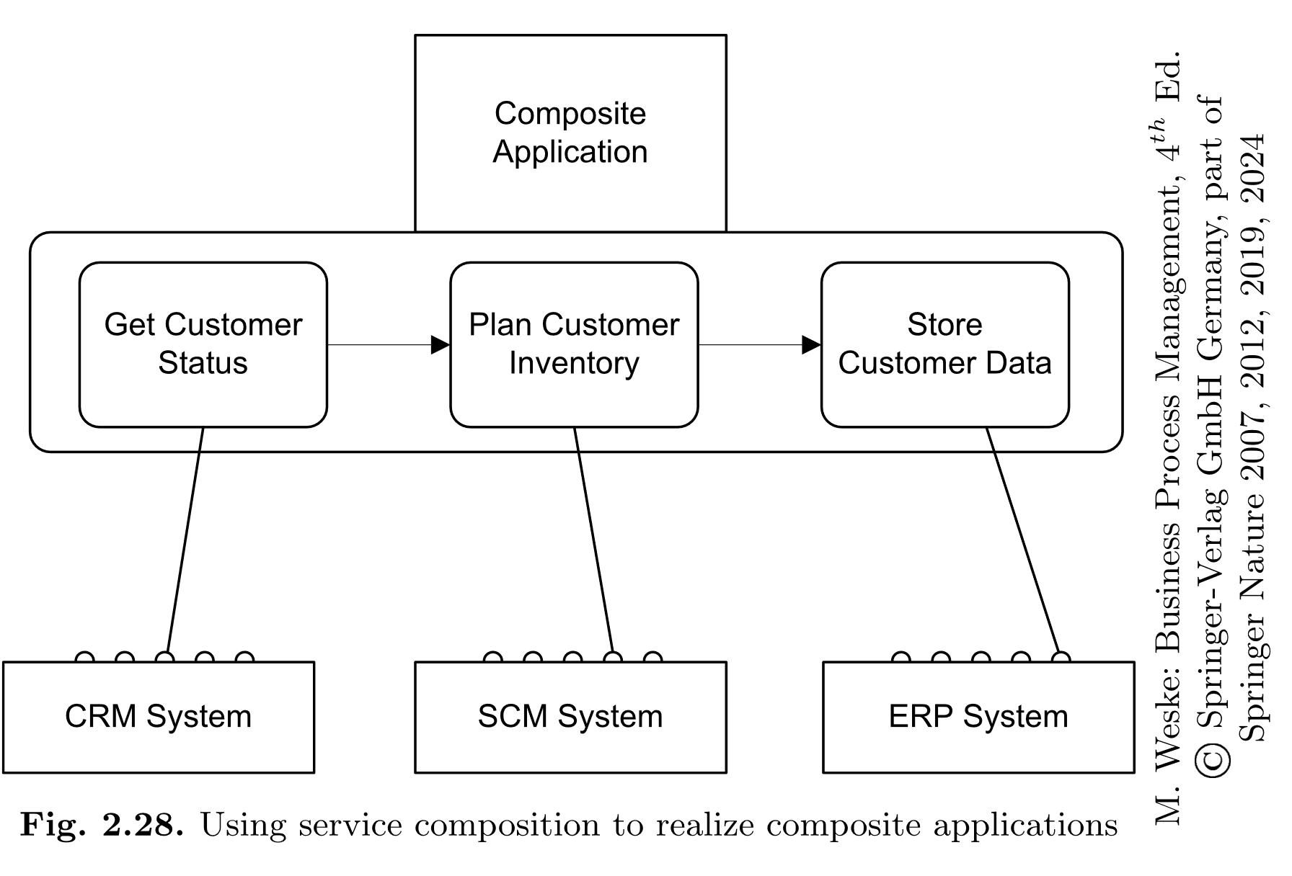

Slide 31
